Slide 1
Multiclass Classification Problem with Convolutional Neural Networks
Big Data Content Analytics
Harper Bush
Maria Nikolatou
Dimitra Afrati

Slide 2

Judging a book by its Cover

Slide 3

CNN Image Classification
Why CNN?
Biologically inspired
Faster Training Process
Better Accuracy

Slide 4
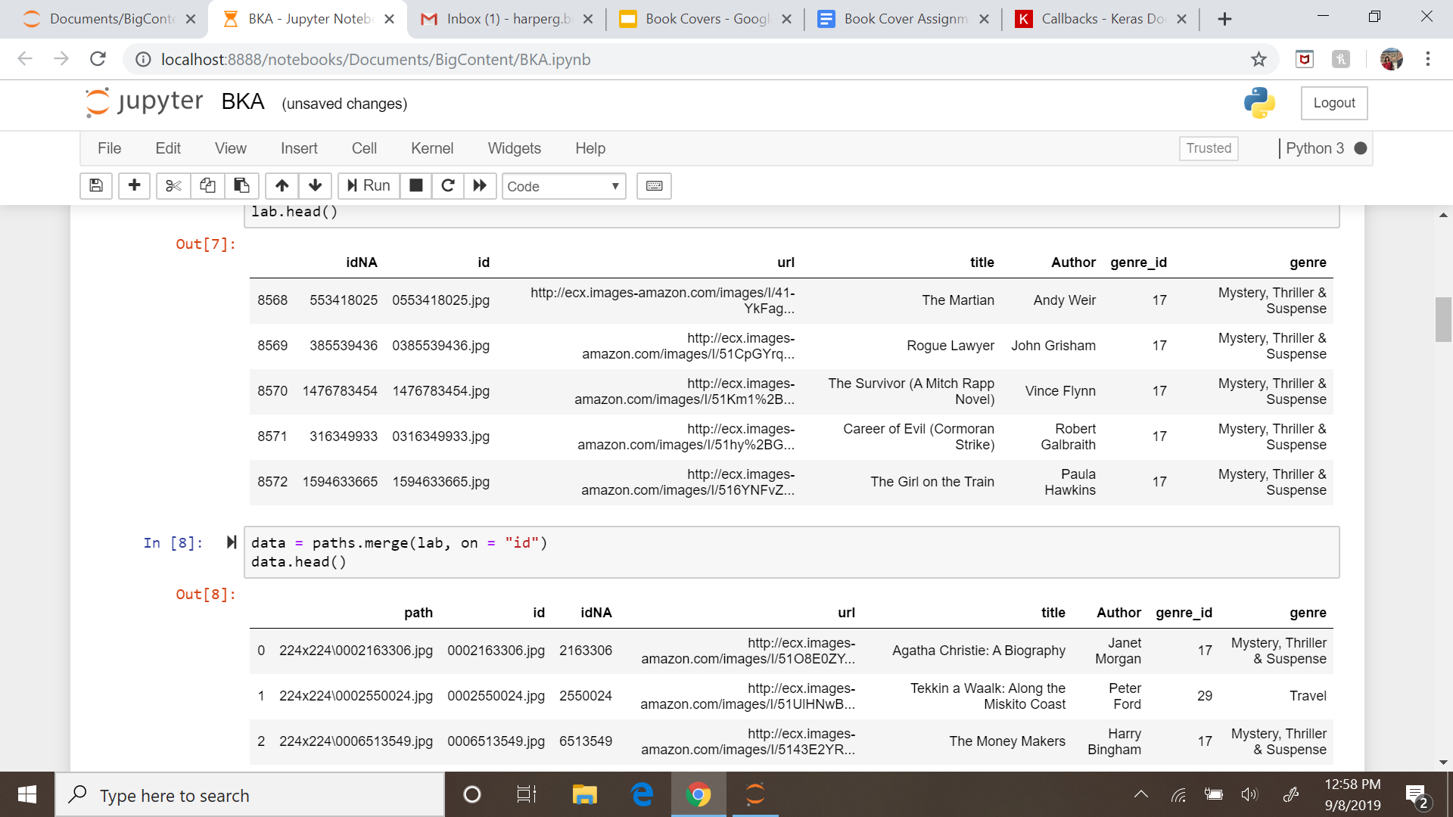
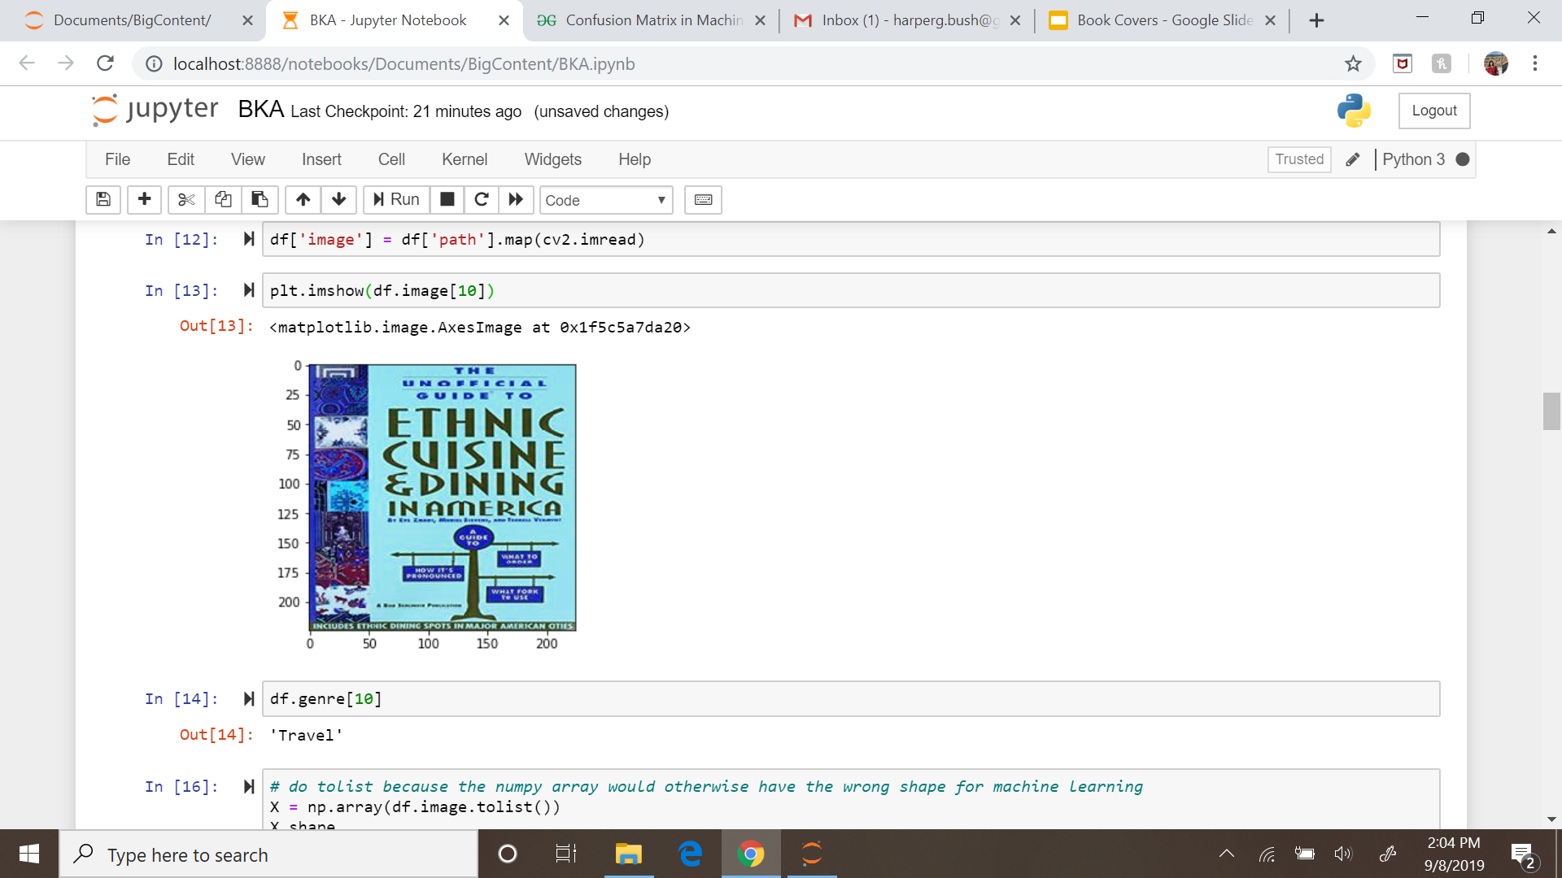
The Dataset
57000 images
31 Initial Categories
One hot encoded
Shrunk to 5 select categories:
Mystery, Thriller and Suspense
Money and Business
Travel
Romance
Medical

Slide 5
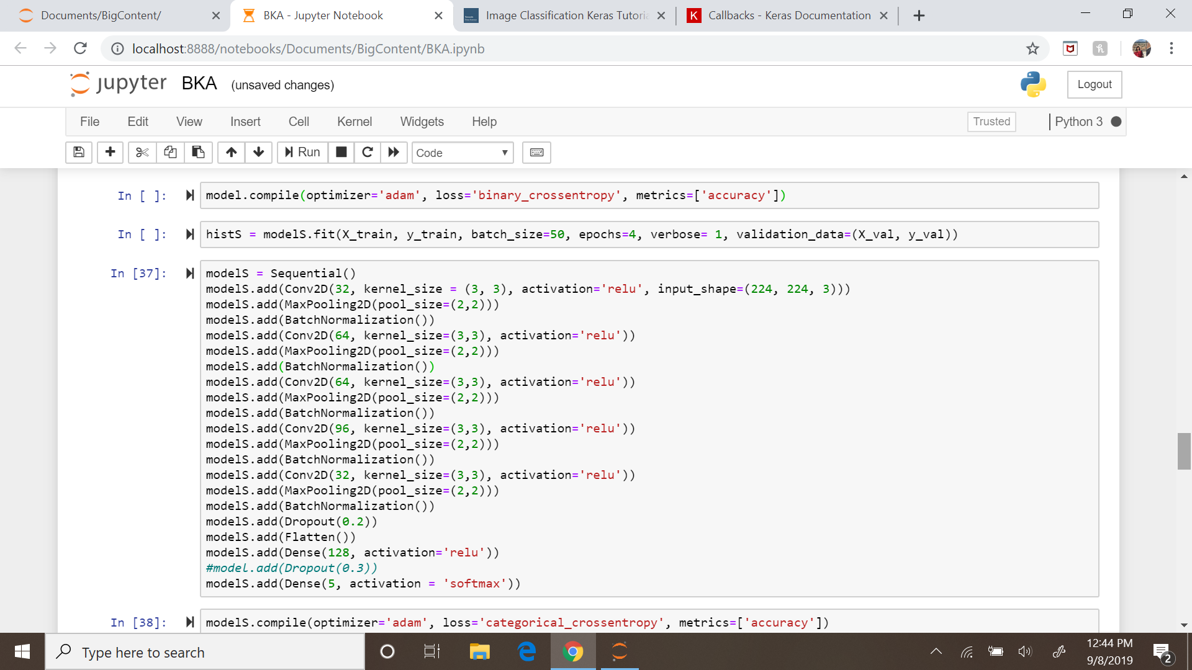
The Model
32 Filters
Kernel Size of (3,3)
ReLU Activation Function
Input Shape (224,224,3)
Dropout Layer
Max Pooling Layer
BatchNormalization layer
Softmax Function

Slide 6
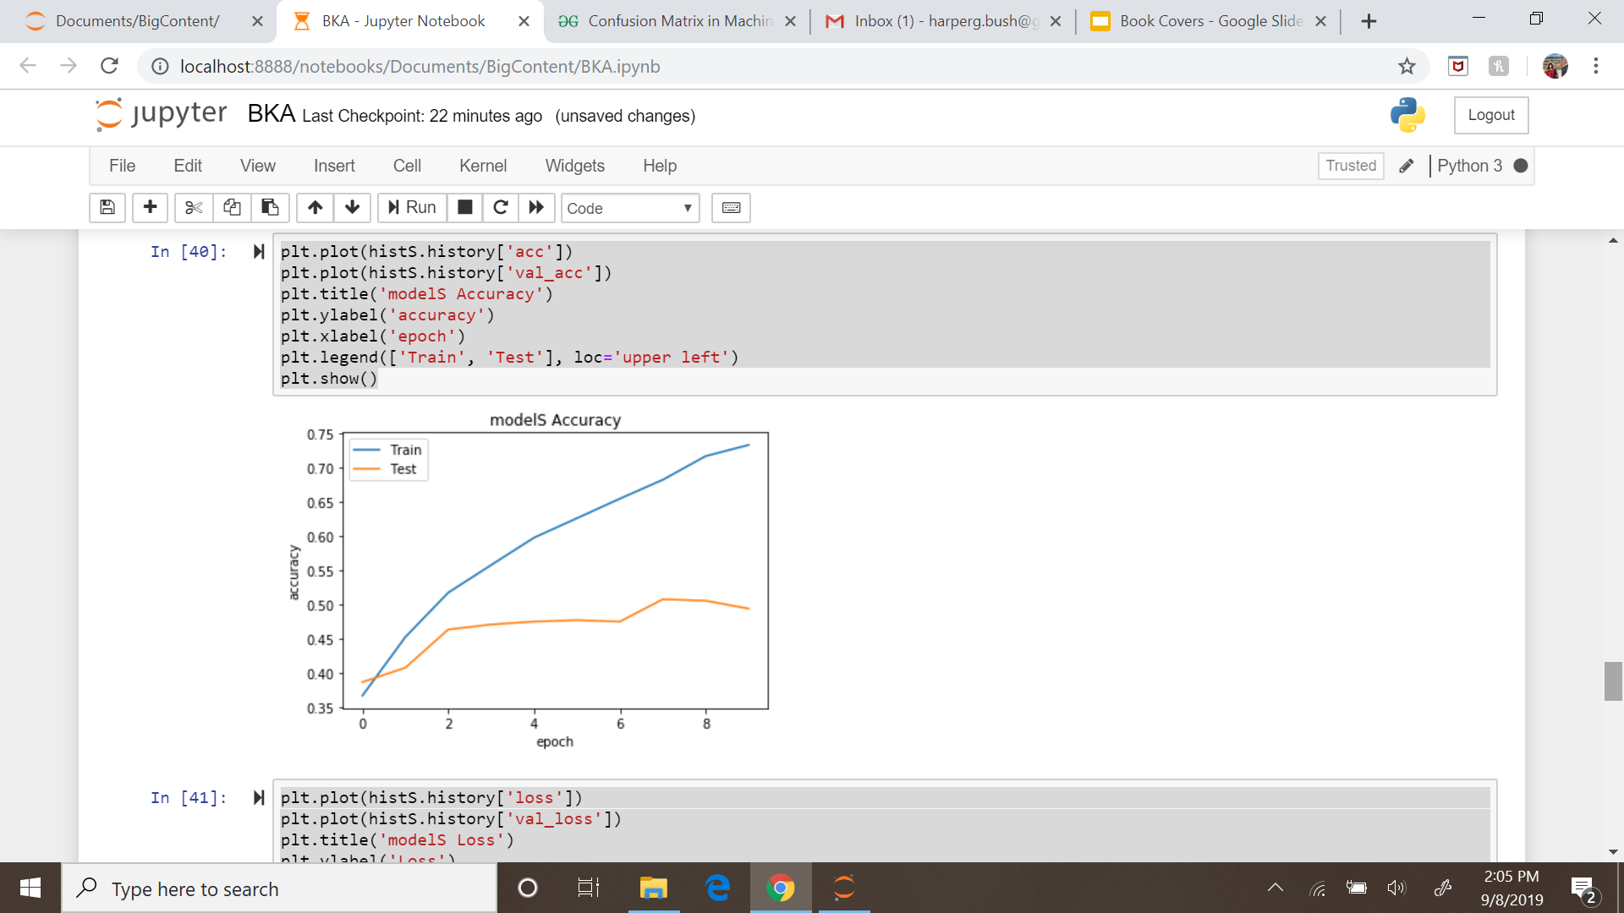
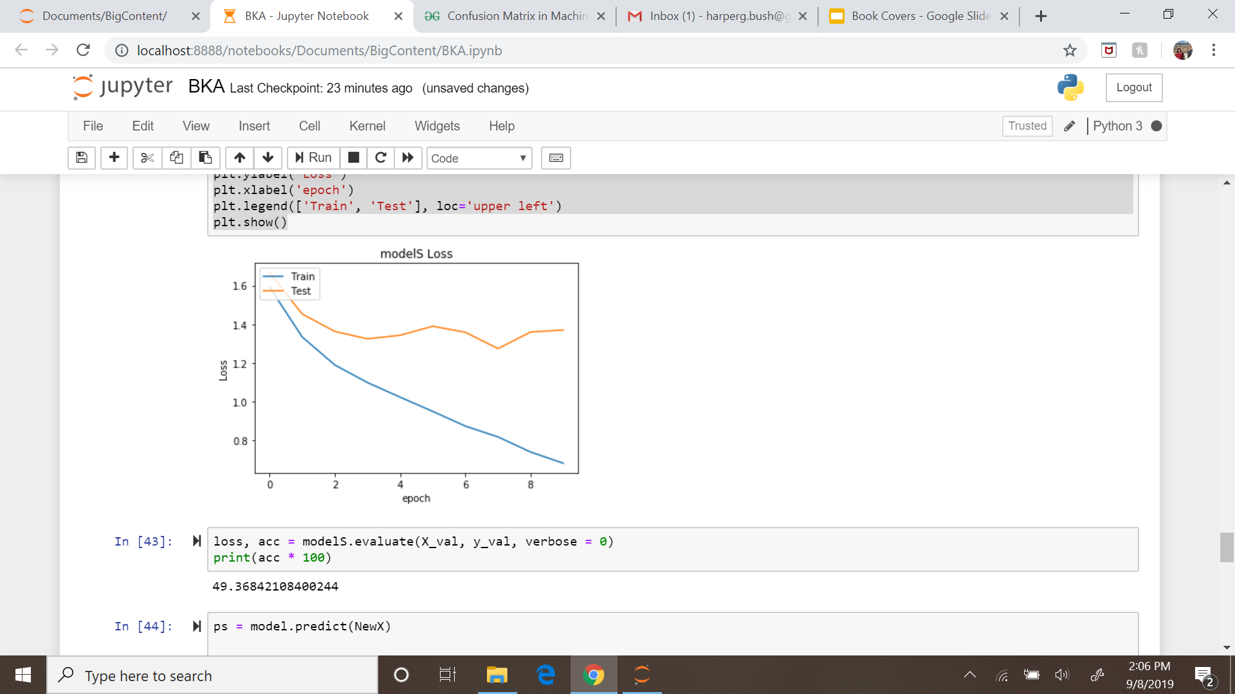
Results
Train accuracy: 75%
Validation accuracy: 50%
Possible improvement by increasing the number of epochs

Slide 7

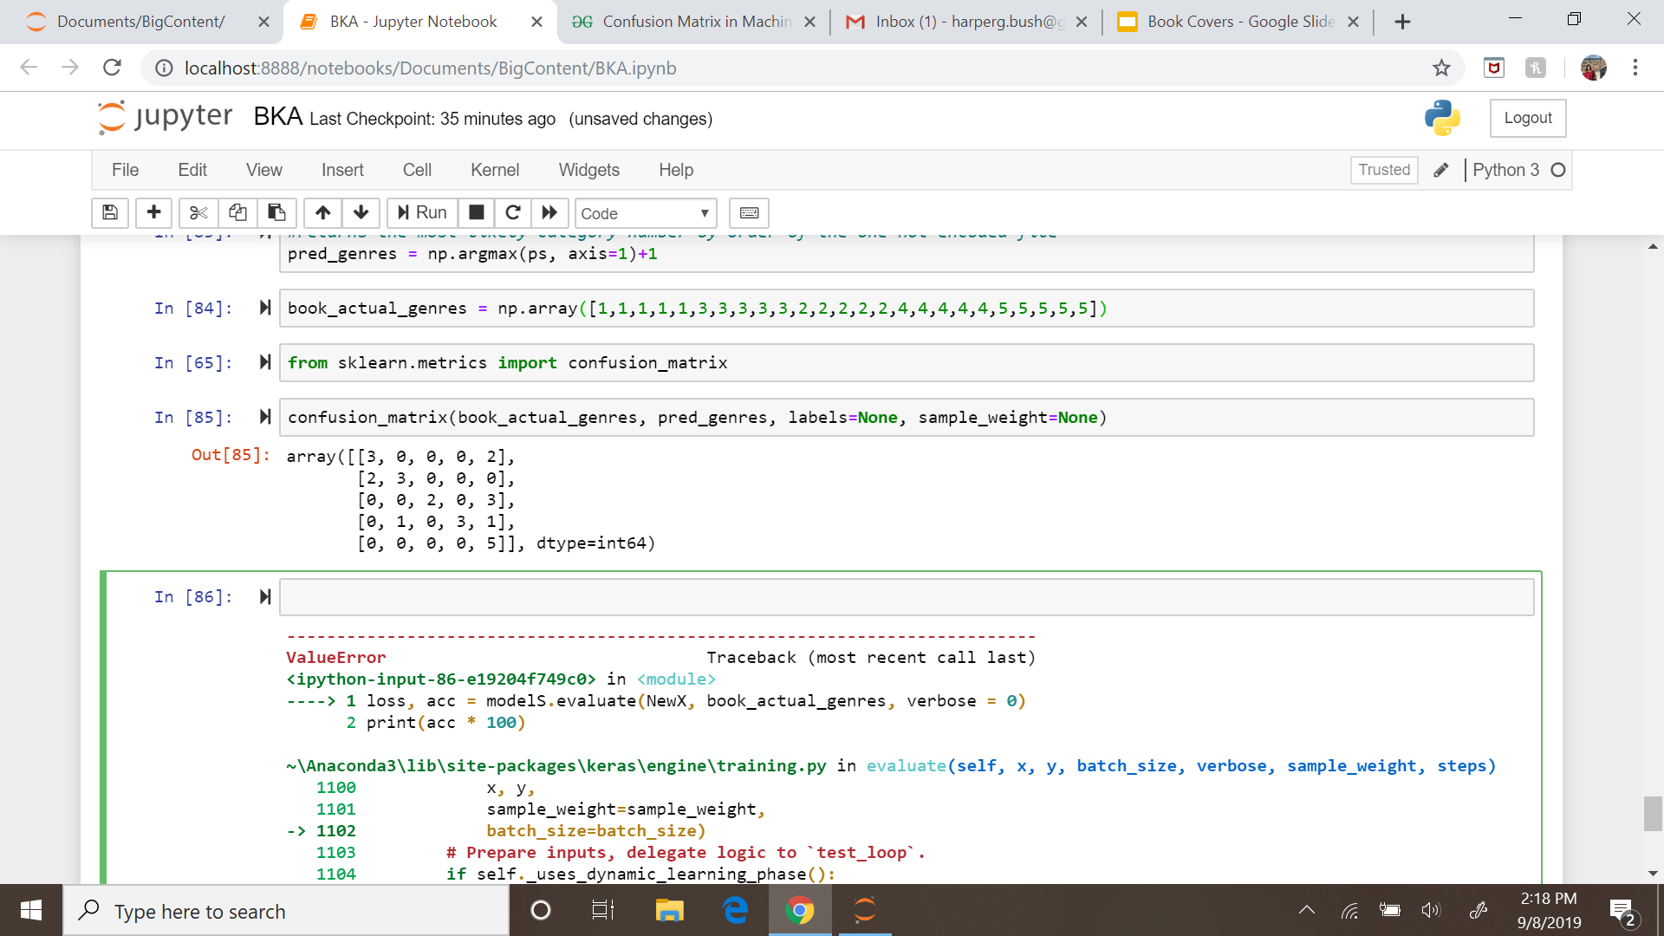
Testing On New Data
25 Images
Photos we took of our own books at home
Photos from the internet
Transformed to 224x224 pixels
Our model is best at identifying travel books (worst at Medical books)
60% correctly predicted

Slide 8
Predictions
Total test size 25 photos
Each category was represented by 5 images in the test data
Metrics for evaluation: Accuracy & Confusion Matrix
The accuracy metric indicates how often the model classified correct the book covers.
Accuracy on Test Data: 60%
Compared to Randomness (20%) increasement in
accurate classification by 40%

Slide 9



Sample Predictions
Category: Travel
Prediction: Travel
[1.26505062e-01, 2.50732508e-02, 7.85804093e-02, 5.03052957e-03, 7.64810741e-01]]
Category: Romance
Prediction: Romance
[1.71138759e-04,1.26438317e-04,2.76215702e-01, 7.23481596e-01, 5.09960591e-06]
Category: Business
Prediction: Travel (incorrect)
[1.70963794e-01,4.83707264e-02,2.59321153e-01, 1.56107679e-01, 3.65236670e-01]

